Slide 1
Chapter 2 First Java Programs
Fundamentals of Java: AP Computer Science Essentials, 4th Edition
Lambert / Osborne

Slide 2
Objectives
Discuss why Java is an important programming language.
Explain the Java virtual machine and byte code.
Choose a user interface style.
Describe the structure of a simple Java program.
Write a simple program.
‹#›
‹#›

Slide 3
Objectives (continued)
Edit, compile, and run a program using a Java development environment.
Format a program to give a pleasing, consistent appearance.
Understand compile-time errors.
Write a simple graphics program.
‹#›
‹#›

Slide 4
Vocabulary
applet
assignment operator
byte code
DOS development environment
graphical user interface (GUI)
hacking
import statement
integrated development environment (IDE)
interpreter
Java virtual machine (JVM)
‹#›
‹#›

Slide 5
Vocabulary (continued)
just-in-time compilation (JIT)
panel
panes
parameter
source code
statement
terminal I/O user interface
variable
‹#›
‹#›

Slide 6
Why Java?
Java is the fastest growing programming language in the world.
Sun, IBM use Java to develop applications.
Java is a modern object-oriented programming language.
‹#›
‹#›

Slide 7
Why Java? (continued)
Java is ideal for distributed, network-based applications.
Secure: Virus-free, tamper-free systems.
Robust: Supports development of programs that do not overwrite memory.
Portable: Yields programs that can be run on different computer types.
‹#›
‹#›

Slide 8
Why Java? (continued)
Java supports advanced programming concepts.
Thread: A process that can run concurrently with other processes.
Java resembles C++.
Easy for a C++ programmer to learn Java.
Java does run more slowly than other languages because it is interpreted.
‹#›
‹#›

Slide 9
The Java Virtual Machine and Byte Code
Java compilers translate Java into Java byte code.
Not machine language
Must install JVM (Java Virtual Machine).
A JVM is an interpreter.
An interpreter is a program that runs like a computer.
An interpreter runs slower than a computer.
‹#›
‹#›

Slide 10
The Java Virtual Machine and Byte Code (continued)
JVMs are getting faster.
Using JIT (just-in-time) compilations, which translate byte code into machine language.
Any computer can run an interpreter.
Makes Java byte code portable.
Java applets
Applets are small programs already translated into byte code that are built into Web sites.
Can be decorative or practical.
‹#›
‹#›

Slide 11
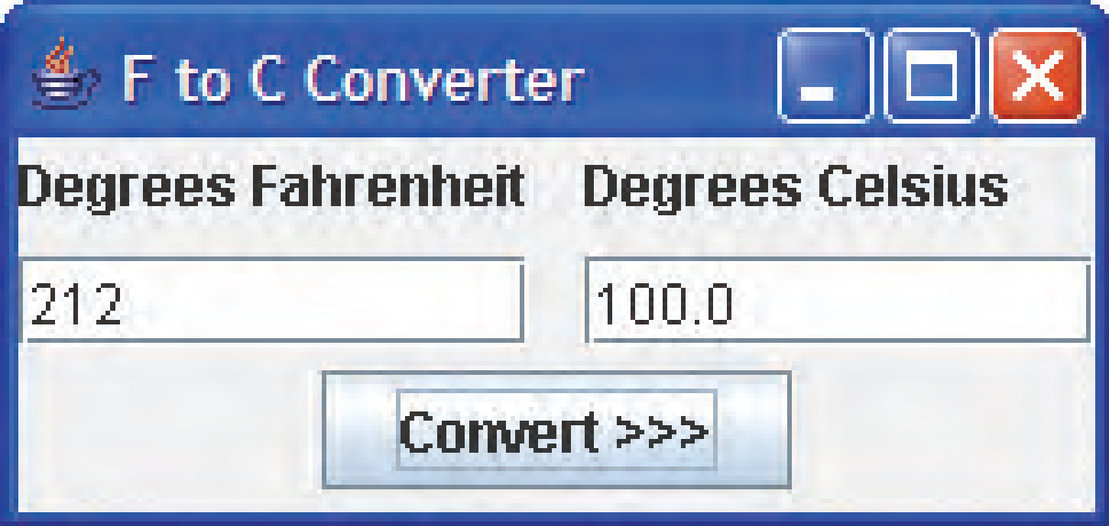
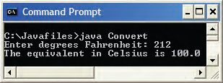
Choosing a User Interface Style
Two user interfaces for a temperature conversion program
Graphical user interface (GUI)
Terminal I/O user interface
‹#›
‹#›

Slide 12
Choosing a User Interface Style (continued)
Why use terminal I/O?
In Java, it’s easier to implement than GUI.
There are programming situations that require terminal I/O.
Terminal-oriented programs are similar in structure to programs that process files of sequentially organized data.
‹#›
‹#›

Slide 13
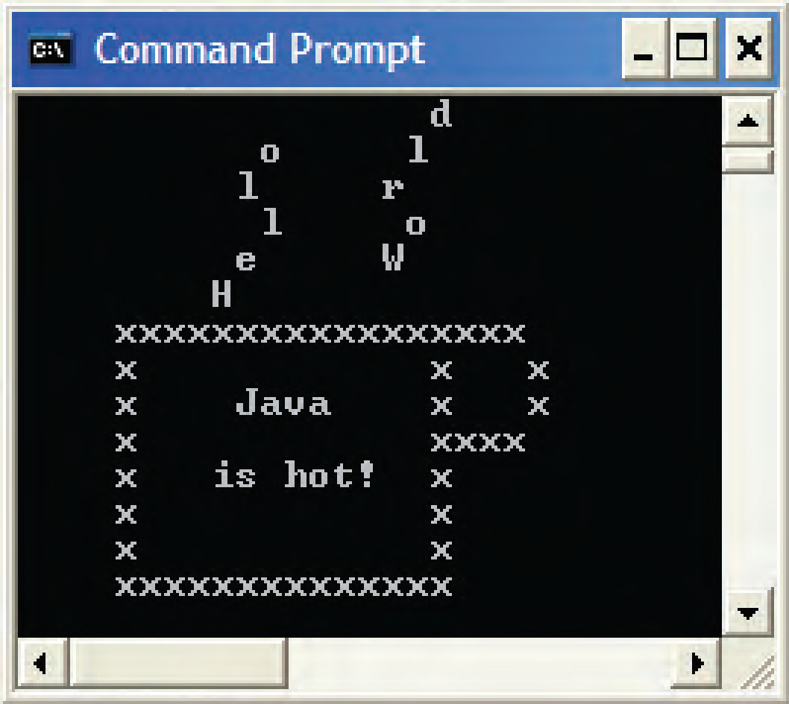
Hello World
“Hello World” is traditionally the first program in a textbook.
Hello world program executed
‹#›
‹#›

Slide 14
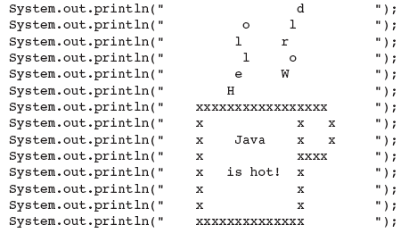
Hello World (continued)
The Source Code:
The bulk of the instructions of a program.
‹#›
‹#›

Slide 15
Hello World (continued)
The Explanation:
System.out is an object that displays characters in a terminal window.
println is the message being sent to the object.
The quotations indicate what is to be displayed.
Semicolons mark the end of each statement.
The characters between the parentheses are the parameters.
The period (.) is the method selector operator.
‹#›
‹#›

Slide 16
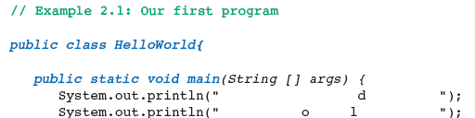
Hello World (continued)
The Larger Framework:
The program must be embedded in several lines of code, such as:
Program comments are in green, reserved words in blue, and code in black.
‹#›
‹#›

Slide 17
Edit, Compile, and Execute
Edit
The programmer uses a word processor or editor to enter the source code.
Save it as a text file with the extension .java.
Compile
The programmer invokes the Java language compiler.
Translates the source code into Java byte code.
‹#›
‹#›

Slide 18
Edit, Compile, and Execute (continued)
Execute
The programmer instructs the JVM to load the byte code into memory and execute.
The user and program can now interact.
‹#›
‹#›

Slide 19
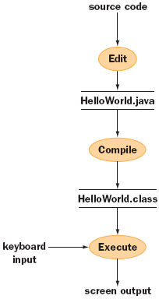
Edit, Compile, and Execute (continued)
Editing, compiling, and running a program
‹#›
‹#›

Slide 20
Edit, Compile, and Execute (continued)
Development Environments:
Unix or Linux | Standard text editor | Free
Microsoft Windows | Notepad and DOS window | Free
Integrated development environment (IDE) | BlueJ, Eclipse, or JGrasp | Not free, but combines editor, compiler, debugger, and JVM
‹#›
‹#›

Slide 21
Edit, Compile, and Execute (continued)
Preparing Your Development Environment:
Create the directory, open a terminal window, and use the cd command.
Open Notepad, create the file HelloWorld.java, then type the code.
Save the file, switch back to the terminal window, and compile the program.
Run the program.
‹#›
‹#›

Slide 22
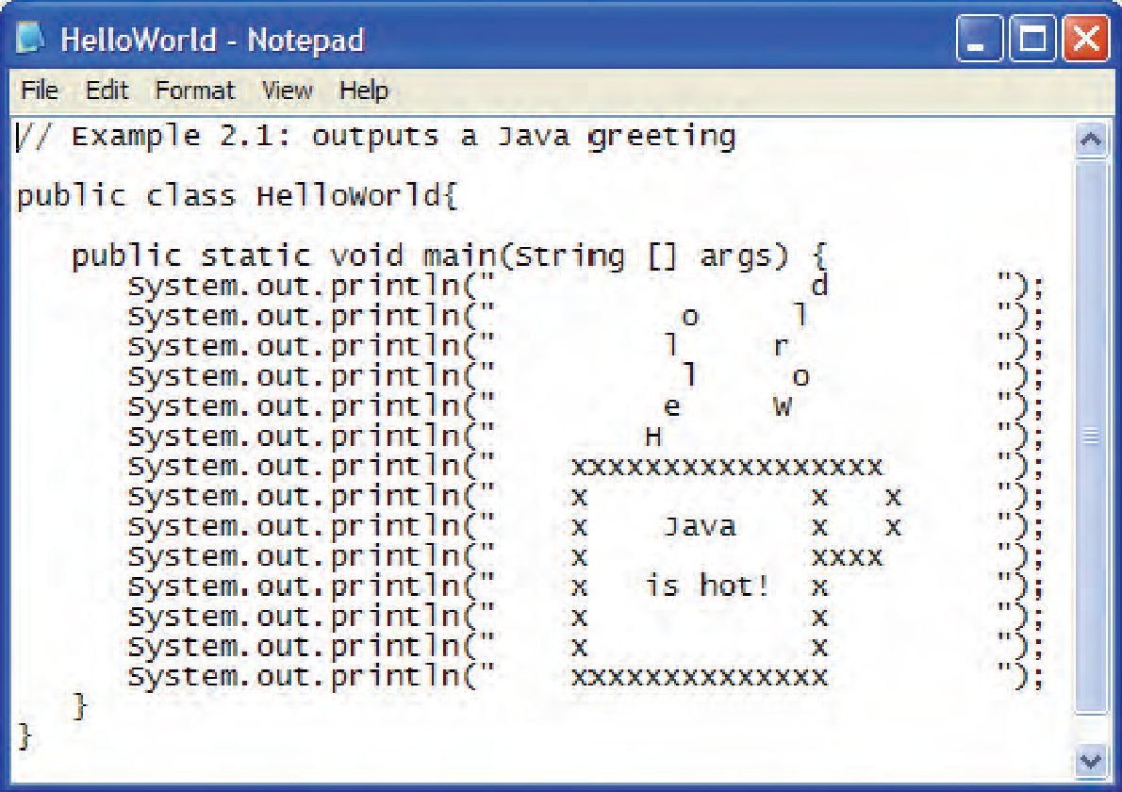
Edit, Compile, and Execute (continued)
The program as typed into Notepad
‹#›
‹#›

Slide 23
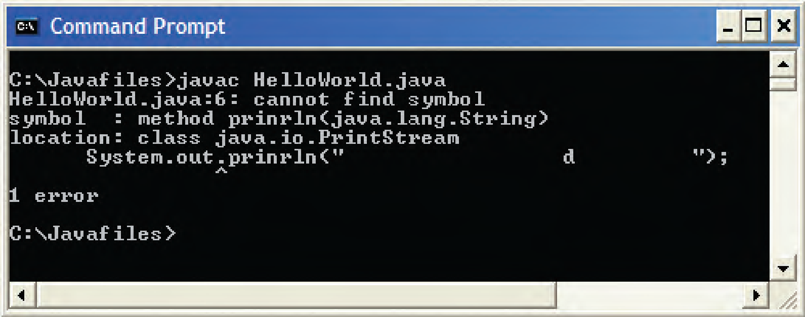
Edit, Compile, and Execute (continued)
Compile-Time Errors:
Mistakes detected by the compiler are called syntax errors or compile-time errors.
Typos made when editing.
Compiler prints a list of errors in the terminal window.
Compiler’s error message
‹#›
‹#›

Slide 24
Edit, Compile, and Execute (continued)
Readability:
Programs may be maintained by other people.
Layout affects readability.
Use indentation, blank lines, and spaces.
‹#›

Slide 25
Temperature Conversion
Temperature conversion program reads user input and performs computations.
The first line of code is an import statement.
Variables for Fahrenheit and Celsius.
Assignment statements use an operator such as *, /, +, and -.
‹#›
‹#›

Slide 26
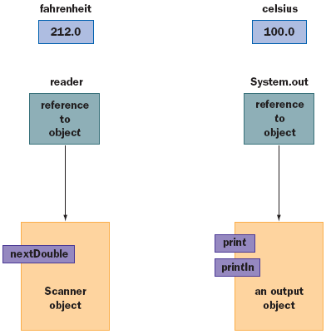
Temperature Conversion (continued)
Variables and objects used in the conversion program
‹#›
‹#›

Slide 27
Graphics and GUIs: Windows and Panels
A Simple Application Window:
Graphics and GUI programs in Java can be stand-alone applications or applets.
Consistent features:
Title bar with controls (maximize, zoom, etc.)
Width and height can be resized
Code for application windows is in the class Jframe.
JFrame responds to messages to set the title bar and window size.
‹#›
‹#›

Slide 28
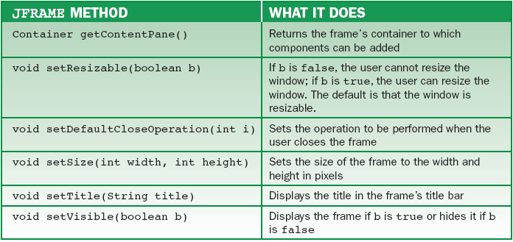
Graphics and GUIs: Windows and Panels (continued)
Some commonly used JFrame methods
‹#›

Slide 29
Graphics and GUIs: Windows and Panels (continued)
Panels and Colors:
A Jframe has a container or pane to fill with objects.
A panel is a rectangle used to display objects such a shapes and images.
Panes are panels that contain related objects such as images and widgets.
Colors in most computer system use RGB.
Red, green, blue
Values 0-255
‹#›
‹#›

Slide 30
Graphics and GUIs: Windows and Panels (continued)
Layout Managers and Multiple Panels:
Each container object uses a layout manager to control panel placement.
BorderLayout class allows arrangement of up to five objects.
North, south, east, west, center
GridLayout uses rows and columns to arrange objects.
‹#›
‹#›

Slide 31
Summary
In this chapter, you learned:
Java is the fastest growing programming language in the world. It is secure, robust, and portable. It is also similar to C++, the world’s most popular programming language.
‹#›
‹#›

Slide 32
Summary (continued)
The Java compiler translates Java into a pseudomachine language called Java byte code. Byte code can be run on any computer that has a Java virtual machine installed. The Java virtual machine (JVM) is a program that behaves like a computer—an interpreter.
Java programs include variables, arithmetic expressions, statements, objects, messages, and methods.
‹#›
‹#›

Slide 33
Summary (continued)
Three basic steps in the coding process are editing, compiling, and running a program using a Java development environment. Programmers should pay attention to a program’s format to ensure readability.
Java programs accomplish many tasks by sending messages to objects. Examples are sending text to the terminal window for output and receiving input data from the keyboard.
There are several user interface styles, among them terminal based and graphical based.
‹#›
‹#›

